Slide 1
Hepatitis B Serology Examples and Explanation

Slide 2
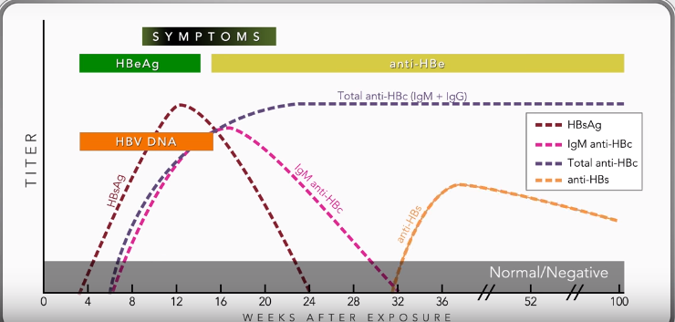
Serologic Course for Acute Hepatitis B
Sourrce: https://www.cdc.gov/hepatitis/resources/professionals/training/serology/training.htm

Slide 3
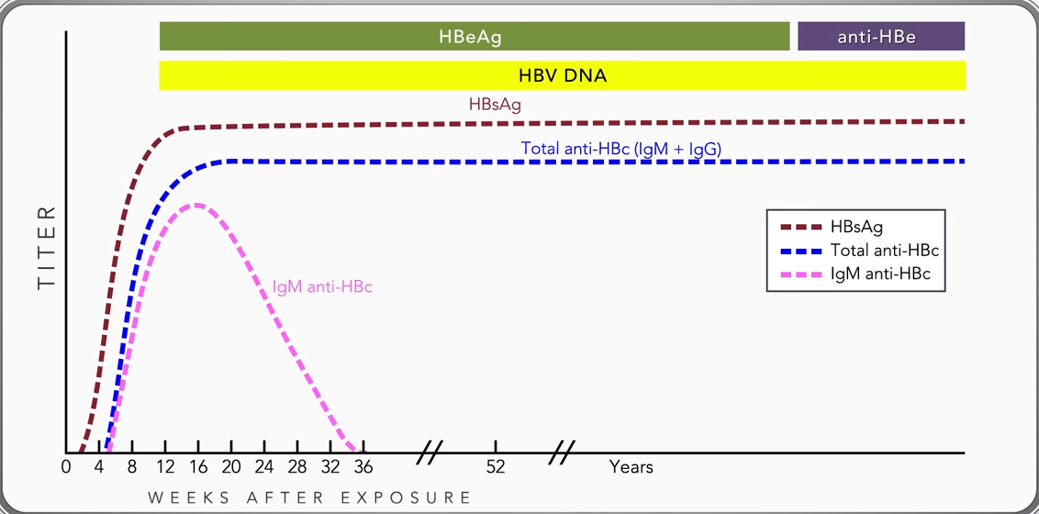
Serologic Course for Chronic Hepatitis B
Source: https://www.cdc.gov/hepatitis/resources/professionals/training/serology/training.htm

Slide 4
Hepatitis B Serology
Hepatitis B Surface Antigen (HBsAg)
Hepatitis B e Antigen (HBeAg)
It can be detected in the blood during acute or chronic Hepatitis B virus infection. The body normally produces antibodies to HBsAg as part of the normal immune response to infection.
A positive test for HBsAg means a person has an acute or chronic Hepatitis B virus infection and can pass the virus to others
A negative test means a person does not have the Hepatitis B virus in his or her blood
A protein found in the blood when the Hepatitis B virus is present and actively replicating.
A positive test means a person has high levels of virus in his or her blood and can easily spread the virus to others. This test is also used to monitor the effectiveness of treatment for chronic Hepatitis B.

Slide 5
Hepatitis B Serology
Hepatitis B DNA (HBV DNA)
Hepatitis B Core Antibody Total (anti-HBc)
A test to detect the presence of Hepatitis B virus DNA in a person’s blood. This test can be reported in different ways, simply as “detected” which means DNA is present or as quantitative results that express how much virus is present in the blood called a “viral load”. Either way it is expressed, a higher number indicates more virus is present making this useful to monitor the effectiveness of drug therapy for Hepatitis B infections.
Is a total of IgM and IgG antibodies produced by the body in response to the presence of Hepatitis B Core antigen (which no test is currently on the market to test for). The meaning of this test often depends on the results of two other tests, anti‐HBs and HBsAg. A positive test means a person is either currently infected with the Hepatitis B virus or was infected in the past. This test should be used with other viral markers to ascertain infection status.

Slide 6
Hepatitis B Serology
Hepatitis B Core Antibody IgM (IgM anti-HBc)
Hepatitis B Surface Antibody (anti-HBs)
Initial antibody produced by the body in response to the presence of Hepatitis B Core antigen. It is used to detect an acute infection. A positive test means a person was probably infected with Hepatitis B virus within the last 6 months. There are some individuals who remain IgM positive throughout their life.
An antibody that is produced by the body in response to the Hepatitis B surface antigen. A positive test means a person is protected or immune from getting the Hepatitis B virus for one of two reasons, successful vaccination against Hepatitis B or recovery from an acute infection.
If a person develops anti-HBs from an active infection it important to note the virus is never gone but rather in an inactive phase.

Slide 7
Scenario 1
Prior Events (Closed Chronic Confirmed) 2019
8/30/21 | HBsAg Nt | (+)
8/30/21 | IgM anti-HBc | (-)
8/30/21 | HBsAg | (+)
8/30/21 | Anti-HBc | (+)
8/30/21 | Anti-HBs | (-)
9/21/21 | HBsAg | (+)
9/21/21 | Anti-HBc | (+)
10/21/21 | HBV DNA | 470

Slide 8
Scenario 2
9/29/21 | HBeAg | (+)
11/3/21 | HBV DNA | Analyte not detecgted

Slide 9
Scenario 3
No Prior Event
12/27/21 | HBV DNA | 18
12/27/21 | HBsAg | (-)
12/27/21 | IgM anti-HBc | (+)
2/11/22 | HBeAb | (+)
2/11/22 | HBeAg | (-)
Notes:
Patient is on HBV treatment and was dx back in 1992.

Slide 10
Scenario 4
Prior Event (Acute confirmed-2 years ago)
7/20/21 | HBsAg | (-)
7/20/21 | IgM Anti-HBc | (+)

Slide 11
Scenario 5
No Prior Events
8/31/21 | Anti-HBc | (-)
11/3/21 | HBsAg | (-)
11/30/21 | HBV DNA | <10 detectable
11/30/21 | HBsAg | (-)
11/30/21 | Anti-HBc | (+)

Slide 12
Scenario 6
No Prior Events
4/19/22 | HBV DNA | 37900000
4/22/22 | HBeAg | (+)
4/18/22 | Symptoms | Yes

Slide 13
Scenario 7
2018 | Prior Event | Probable
4/8/22 | HBV DNA | 24300

Slide 14

Scenario 8
4/1/22 | HBsAg | (+)
4/1/22 | HBeAg | (-)
4/1/22 | HBV DNA | (-)
3/28/21 | Symptoms | Yes

Slide 15
Scenario 9
10/18/21 | HBsAG | (+)
10/18/21 | Anti-HBc | (-)
11/3/21 | HBsAg | (-)
10/18/21 | Symptoms | Yes
Pt recently hospitalized and MR states pt undergoes dialysis M/W/F

Slide 16
Scenario 10
3/22/22 | HBV DNA | <10 (not detectable or detectable)

Slide 17
Scenario 11
1/19/22 | IgM anti-HBC | (+)
1/19/22 | Symptoms | Yes

Slide 18
Scenario 12
2021 | Prior Event | Confirmed
4/12/22 | HBsAg | (-)
4/12/22 | HBeAg | (+)
4/12/22 | Anti-HBc | (+)

Slide 19
Scenario 13
No Prior Events
2/12/22 | HBsAg | (+)
2/12/22 | IgM Anti-HBc | (+)
2/12/22 | Symptoms | Only-ALT 345

Slide 20
Scenario 14
No Prior Events
3/25/22 | HBeAG | (+)
3/25/22 | HBV DNA | Analyte not detected
3/23/22 | Anti-HBC | (-)

Slide 21
Scenario 15
No Prior Events
2/23/22 | IgM Anti-HBC | (+)
5/03/22 | IgM Anti-HBC | (+)
5/03/22 | HBsAg | (+)

Slide 22
Scenario 16
No Prior Event
1/16/22 | HBV DNA | <10 Detected

Slide 23
Scenario 17
Prior Event (Closed Chronic Confirmed) & Currently Pregnant
4/2/20 | HBsAg | (+)

Slide 24
Scenario 18
Prior Events (Chronic Probable from 2016) Currently Pregnant and Prior Pregnancies
8/16/20 | HBsAg | (+)
9/23/21 | HBsAg | (+)
9/23/21 | HBV DNA | 76256
5/27/22 | HBsAg | (+)

Slide 25
Scenario 19
Prior event (Acute Confirmed) July 2020
9/17/20 | HBsAg | (-)
9/17/20 | IgM Anti-HBc | (+)
9/17/20 | Anti-HBC | (+)

Slide 26
Scenario 20
Prior Event- Open lab condition report from 2021
5/22/22 | HBsAg | (-)
5/22/22 | IgM Anti-HBC | (+)
5/22/22 | HBeAg | (+)

Slide 27
Scenario 21
Prior Event (Chronic confirmed) 2022
2/3/22 | HBeAg | (+)

Slide 28
Scenario 22
No Prior Events
1/22/21 | HBeAg | (+)
1/22/21 | Anti-HBc | (+)

Slide 29
Scenario 23
No Prior Events
7/12/21 | HBeAg | (+)
7/12/21 | HBeAb | (-)

Slide 30
Scenario 24
No Prior Events
5/5/22 | HBsAg | (+)
5/5/22 | Anti-HBC | (-)
5/5/22 | Anti-HBs | (-)
5/9/22 | HBV DNA | 1780
5/9/22 | HBeAg | (+)

Slide 31
Scenario 25
Prior Event (Chronic Probable)- 3/21/20
4/22/22 | HBV DNA | 6244946
4/22/22 | Anti-HBC | (+)
4/22/22 | HBsAG | (+)

Slide 32
Scenario 26
Prior Event (Closed Chronic Confirmed)-5-16-2019; Female aged 32
3/22/22 | HBeAg | (+)
3/22/22 | HBV DNA | (+)

Slide 33
Scenario 27
No Prior Events- NO S/S
4/17/22 | Anti-HCV | (+)
4/17/22 | HCV RNA | (-)

Slide 34
Scenario 28
Prior Event (Closed Chronic Probable) 2/22/22- Abd pain, ALT 379 with jaundice
5/17/22 | HCV RNA | 32659000
5/17/22 | Anti-HCV | (-)

Slide 35
Scenario 29
Prior Events (Acute Confirmed Closed) 1/22/2018) (-) HCV RNA 2019 no further testing since. Currently has ALT 768
12/19/21 | Anti-HCV | (+)
12/19/21 | HCV RNA | (+)

Slide 36
Scenario 30
Prior Event (Open Chronic Confirmed) 3/1/22; no current S/S
5/2/22 | Anti-HCV | (+)
5/2/22 | HCV RNA | (-)

Slide 37

Contacts
Brian S. Gravlin, RN
Viral Hepatitis Surveillance Nurse
918-237-5593 (cell phone)
brian.gravlin@dhhs.nc.gov

